Slide 1
Message
Notes:
Come Holy Spirit,
Reveal the heart of our Father.
Come Holy Spirit,
Reveal the ways of Jesus.
Come, Holy Spirit, with power
and deep conviction, for we ask it in Jesus’ name, Amen.

Slide 3
‘As for you, you were dead in your transgressions and sins, in which you used to live when you followed the ways of this world and of the ruler of the kingdom of the air...All of us also lived among them at one time…’
(Eph. 2:1-3)

Slide 4
‘…you followed the ways of this world and of the ruler of the kingdom of the air...gratifying the cravings of our flesh and following its desires and thoughts.…’
(Eph. 2:1-3)

Slide 5
‘And you can see it…blindness to the glory of Jesus Christ, and deaf to the voice of the Holy Spirit…no love for God, no sensitive awareness of his personal reality, no leaping in spirit towards Him as ‘Abba, Father’ …unresponsive towards Him as a corpse.’ (John Stott, Ephesians)

Slide 6
‘Like the rest, we were by nature deserving of wrath.’
(Eph. 2:4)

Slide 7
We walked the path of death

Slide 8
‘But because of his great love for us, God, who is rich in mercy, made us alive with Christ even when we were dead in transgressions – it is by grace you have been saved.’
(Eph. 2:4-5)
But God…acted!

Slide 10
‘For it is by grace you have been saved, through faith – and this is not from yourselves, it is the gift of God – not by works, so that no one can boast.’
(Eph. 2:8-9)
But God…acted!

Slide 11
‘God…made us alive with Christ…And raised us up with Christ and seated us with him in the heavenly realms in Christ Jesus…For we are God’s handiwork, created in Christ Jesus to do good works, which God prepared in advance for us to do.’ (Eph. 2:5-6, 10)

Slide 12
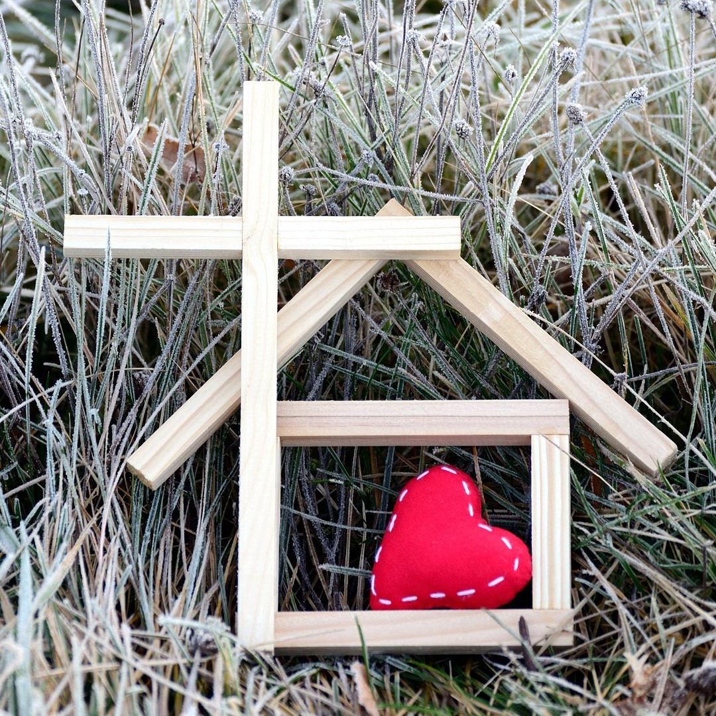
‘We were the beggars
Now we're royalty
We were the prisoners
Now we're running free
We are forgiven, accepted
Redeemed by His grace’
(House of the Lord)

Slide 13
We walked in the
way of death
But God acted!
Now we walk the
path of new life in Jesus
Ephesians 2:1-10

Slide 14
MP-33 And can it be

